Slide 1

Green Pace
Security Policy Presentation
Developer: Sarah Snow

Slide 2

OVERVIEW: DEFENSE IN DEPTH
This security policy is necessary to create a robust and multi-layered defense system, that will deter various attacks by malicious users.

Slide 3
THREATS MATRIX
Likely Likely security risks are risks that have a high likelihood to occur because of gaps in the security coding standard, such as SQL Injection prevention. | Priority Priority threats are threats with high likelihood that pose the most detrimental threats to sensitive data and resources. SQL Injection would also fall under this category.
Low Priority Low priority threats, while still likely, pose less of a threat to sensitive data, but should still be addressed. | Unlikely Unlikely threats are threats with a low chance of happening, but their priority or severity are not determined by their likelihood.

Slide 4
10 PRINCIPLES
Validate Input Data
Data Type
Data Value
String Correctness
SQL Injection
Assertions
Call Functions With Correct Arguments
Heed Compiler Warnings
Memory Protection
Do Not Access Freed Memory
Architect and Design for Security Policies
Modifying String Literals
Keep It Simple
Data Type
Data Value
Memory Protection
Exceptions
Default Deny
Modifying String Literals
Adhere to the Principle of Least Privilege
Modifying String Literals
Sanitize Data Sent to Other Systems
String Correctness
SQL Injection
Practice Defense in Depth
Memory Protection
Exceptions
Do Not Access Freed Memory
Call Functions With Correct Arguments
Use Effective Quality Assurance Techniques
Assertions
Adopt a Secure Coding Standard
All!

Slide 5
CODING STANDARDS
SQL Injection
Memory Protection
Do Not Access Freed Memory
Exceptions
Data Value
String Correctness
Modifying String Literals
Call Functions With Correct Arguments
Data Type
Assertions
These standards are listed in an order of priority. My organizational system is based first on level of severity, then likelihood, balanced with remediation cost.

Slide 6
ENCRYPTION POLICIES
Encryption at Rest: Used to encrypt data during storage on devices such as databases, cloud servers, or hard drives. This prevents unauthorized access by using algorithms to encrypt entire disks. This applies whenever sensitive data is stored. It ensures that the data remains protected if the storage device is accessed without authorization.
Encryption in Flight: Used to secure data during transmission over a network, ensuring confidentiality and prevents interception. It is used to secure systems and communication between them such as servers or applications and databases. This is applied whenever data is transmitted over untrusted networks. It ensures the confidentiality of sensitive data. Use end-to-end protection, secure and updated libraries.
Encryption in Use: Used to encrypt data while it is being used by an application. The data stays encrypted using cryptographic libraries or APIs. Use identity management and the principle of least privilege.

Slide 7
TRIPLE-A POLICIES
Authentication: Verifies the identity of users accessing a system or application. Authentication usually uses passwords, biometrics, multi-factor authentication (MFA), and single sign-on (SSO). It also controls access to systems or data based on the identity of users. This applies whenever access control is required to protect the integrity sensitive data.
Authorization: Determines the permissions given to verified users. This employs the principle of least privilege, using control lists (ACLs), attribute-based access control (ABAC), and role-based access control (RBAC).
Accounting: Traces and records user activity involving a system. It ensures security by using audit trails, logging, etc. This helps detect malicious use of a system and applies whenever a user is accessing a system.

Slide 8
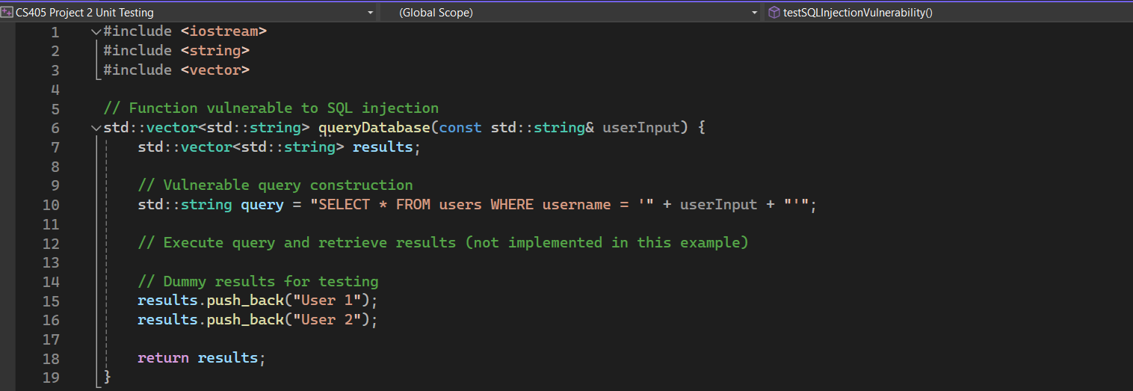
Unit Testing
I will now provide examples of how to test for the SQL Injection vulnerability. Below is the function that would be vulnerable to SQL Injection.

Slide 9
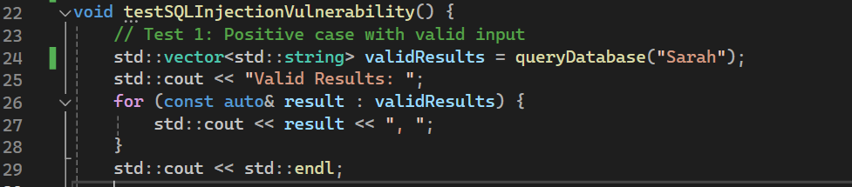
Positive Test With Valid Input

Slide 10
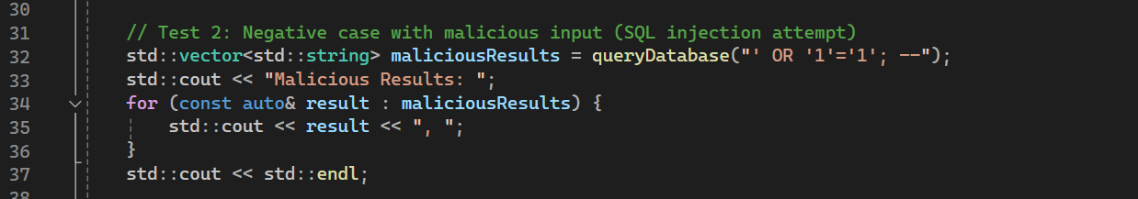
Negative Test With Malicious Input

Slide 11
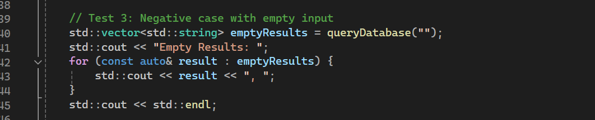
Negative Test With Empty Input

Slide 12
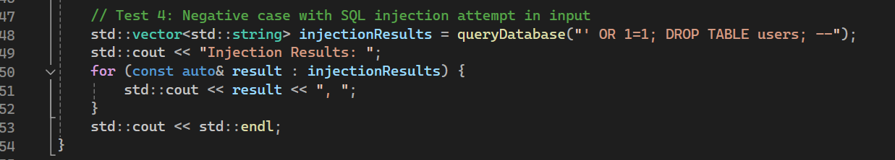
Negative Test With Injection Attempt

Slide 13
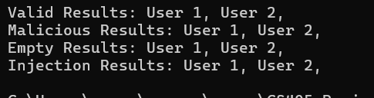
Console Output For Unit Tests

Slide 14

AUTOMATION SUMMARY

Slide 15
TOOLS
Automation will be used for the enforcement of and compliance to the standards defined in this policy. Green Pace already has a well-established DevOps process and infrastructure. Automating the enforcement of the standards in the security policy should be integrated throughout the entire process and infrastructure.
Access and Planning Phase: This is where project requirements should include security requirements. This includes secure coding practices such as data type validation and input sanitization. User stories and acceptance criteria should also consider security.
Design and Build Phases: This is where security checks should be integrated. This is where static code analysis tools be implemented into the IDEs to provide immediate feedback regarding security issues.
Verify and Test Phase: This should have automated security testing integrated into it. Static and dynamic analysis tools for runtime testing can identify potential vulnerabilities. Test cases that are security focused should be included. This is also where the code should be submitted for a security review before it is released to production.
Transition and Health Check Phase: Controls should be integrated to securely configure the environment. Access controls and encryption should be implemented in this phase. Continuous monitoring and logging should be implemented in the monitor and detect phase. This can catch attacks in real time. Security information and event management (SIEM) tools can automate the detection of suspicious activity.
Response Phase: This is where procedures should be implemented to ensure a timely and organized response to threats and events.

Slide 16
RISKS AND BENEFITS
Acting now to implement the security measures outlined in the policy can reduce the organization's vulnerabilities, protect sensitive data, as well as protect against potential breaches. Delaying action increases the organization’s risk of cyber attacks, potentially resulting in severe consequences such as data breaches, leading to reputational damage and financial loss.
What this policy may lack is sufficient emphasis on continuous monitoring and subsequent incident response. While preventive measures are essential and well thought out in this policy, early detection and sufficient response to security incidents are just as crucial for an effective defense-in-depth approach.

Slide 17
RECOMMENDATIONS
Enhance monitoring and detection through implementing monitoring tools, detection systems, and security information and event management (SIEM) solutions.
Establish an incident response team with procedures that conduct regular incident response tests to ensure readiness.

Slide 18
CONCLUSIONS
Invest in continuous education and training. Educate staff about cybersecurity best practices, threats, and their role.
Remain agile and adaptable to emerging trends in security measures. This will keep the standards evolving as threats evolve.

Slide 19
REFERENCES
N/A

